Slide 1
Movies part 5
Barb Ericson
Georgia Institute of Technology
April 2006

Slide 2
Learning Goals
Media Goals
  To do movie special effects like chromakey
    Replace the background in a movie
  To do color correction on a movie
Computing Concepts
  To add parameters to methods to make them reusable
  To reuse earlier methods in making movies

Slide 3
Changing the Background of a Movie
Many movies are shot in front of a blue or green screen
And then the green or blue is replaced with a different background
  So that the action looks like it is happening somewhere else
There is a movie of three kids crawling in front of a blue screen in the folder kids-blue
  Use chromakey to put them on the moon

Slide 4
Add Parameters to Chromakey
The chromakey method will be more reusable
  If we pass in the color to replace with the new background picture
  In the kids-blue movie the sheet is blue but without proper lighting it is closer to black
You can have several methods with the same name in a class
  As long as the parameter list is different

Slide 5
Chromakey Method
public void chromakey(Picture newBg, Color color
double dist)
{
Pixel currPixel = null;
Pixel newPixel = null;
// loop through the columns
for (int x=0; x<getWidth(); x++)
{
// loop through the rows
for (int y=0; y<getHeight(); y++)
{

Slide 6
Chromakey Method - Cont
// get the current pixel
currPixel = this.getPixel(x,y);
/* if the color at the current pixel is mostly blue
* (blue value is greater than red and green combined),
* then use the new background color
*/
double currDist = currPixel.colorDistance(color);
if (currDist <= dist)
{
newPixel = newBg.getPixel(x,y);
currPixel.setColor(newPixel.getColor());
}
}
}
}

Slide 7
Code for Kids on Moon Movie
public void makeKidsOnMoonMovie(String dir)
{
String kidsDir = FileChooser.getMediaPath("kids-blue/");
String moonF = FileChooser.getMediaPath("moon-surface.jpg");
Picture moonP = new Picture(moonF);
FrameSequencer frameSequencer = new FrameSequencer(dir);
Picture currP = null;
// get the array of files in the directory
File dirObj = new File(kidsDir);
String[] fileArray = dirObj.list();

Slide 8
Code for Kids on Moon Movie - Cont
// loop through the array of files
for (int i = 0; i < fileArray.length; i++)
{
if (fileArray[i].indexOf(".jpg") >= 0)
{
currP = new Picture(kidsDir + fileArray[i]);
currP.chromakey(moonP,Color.black,100.0);
frameSequencer.addFrame(currP);
}
}
// play the movie
frameSequencer.play(30);
}

Slide 9
Main for Testing
public static void main(String[] args)
{
MovieMaker movieMaker = new MovieMaker();
String dir = "c:/intro-prog-java/movies/moon/";
movieMaker.makeKidsOnMoonMovie(dir);
}
Notes:
You can change the directory to any empty directory.

Slide 10
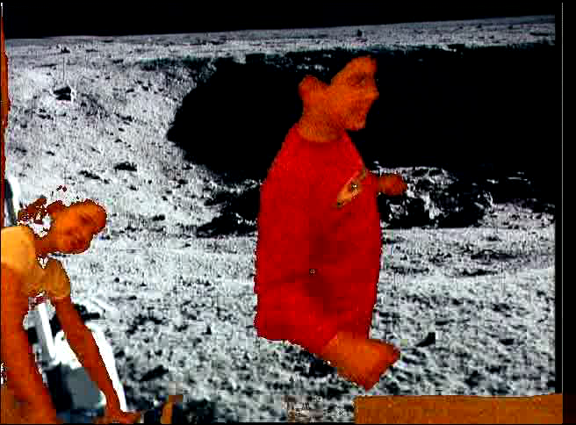
Kids on the Moon Movie
Notes:
This mpeg file was created with ImageMagick using
convert –adjoin –border 1 –bordercolor black frame*.jpg frame.mpeg
Click on the movie to play it.

Slide 11
Exercise
Create a new method in MovieMaker
First take a movie with a student doing some action in front of a blue or green screen
  You can make a screen out of paper
Use the MediaTools to pull turn the frames into JPEG
Put the student on the moon or on the beach instead in the movie

Slide 12
Correcting the Color in a Movie
Movies shot underwater look too blue
  Water filters out red and yellow light
  See the images in the fish directory
Add a new Picture method that will change the red and green values by passed multipliers
  Yellow is a mixture of red and green
  Call the new method changeRedAndGreen

Slide 13
Change Red and Green Method
public void changeRedAndGreen(double redMult,
double greenMult)
{
Pixel[] pixelArray = this.getPixels();
Pixel pixel = null;
int value = 0;
int index = 0;
// loop through all the pixels
while (index < pixelArray.length)
{
// get the current pixel
pixel = pixelArray[index];
Notes:
Put this in the Picture class.

Slide 14
Change Red and Green Method - Cont
// change the red value
value = pixel.getRed();
pixel.setRed((int) (value * redMult));
// change the green value
value = pixel.getGreen();
pixel.setGreen((int) (value * greenMult));
// increment the index
index++;
}
}

Slide 15
Code for Fish Movie
public void makeFishMovie(String dir)
{
String movieDir = FileChooser.getMediaPath("fish/");
FrameSequencer frameSequencer = new FrameSequencer(dir);
Picture currP = null;
// get the array of files in the directory
File dirObj = new File(movieDir);
String[] fileArray = dirObj.list();

Slide 16
Code for Fish Movie - Cont
// loop through the array of files
for (int i = 0; i < fileArray.length; i++)
{
if (fileArray[i].indexOf(".jpg") >= 0)
{
currP = new Picture(movieDir + fileArray[i]);
currP.changeRedAndGreen(2.0,1.5);
frameSequencer.addFrame(currP);
}
}
// play the movie
frameSequencer.play(16);
}

Slide 17
Main for Testing
public static void main(String[] args)
{
MovieMaker movieMaker = new MovieMaker();
String dir = "c:/intro-prog-java/movies/fish/";
movieMaker.makeFishMovie(dir);
}
Notes:
You can change the directory to any empty directory.

Slide 18
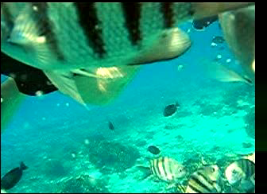
The Fish Movie
Notes:
This mpeg file was created with ImageMagick using
convert –adjoin –border 1 –bordercolor black frame*.jpg frame.mpeg
Click on the movie to play it.

Slide 19
Exercise
Find a digital movie that is too dark or make one yourself
Use MediaTools to get the JPEG frames from the movie
Create a movie that has each frame lightened
  You can even change the amount you lighten each frame

Slide 20
Summary
Movies and video are a series of pictures
  Shown quickly one after the other
The frames rate is the number of frames shown per second
  Need at least 16 fps (frames per second)
  Digital Video is 30 fps
Movies take up quite a bit of space
  So they are stored in a compressed form
Adding parameters to methods makes them more reusable
You can have several methods with the same name in the same class
  The parameter list must be different!

